Slide 1
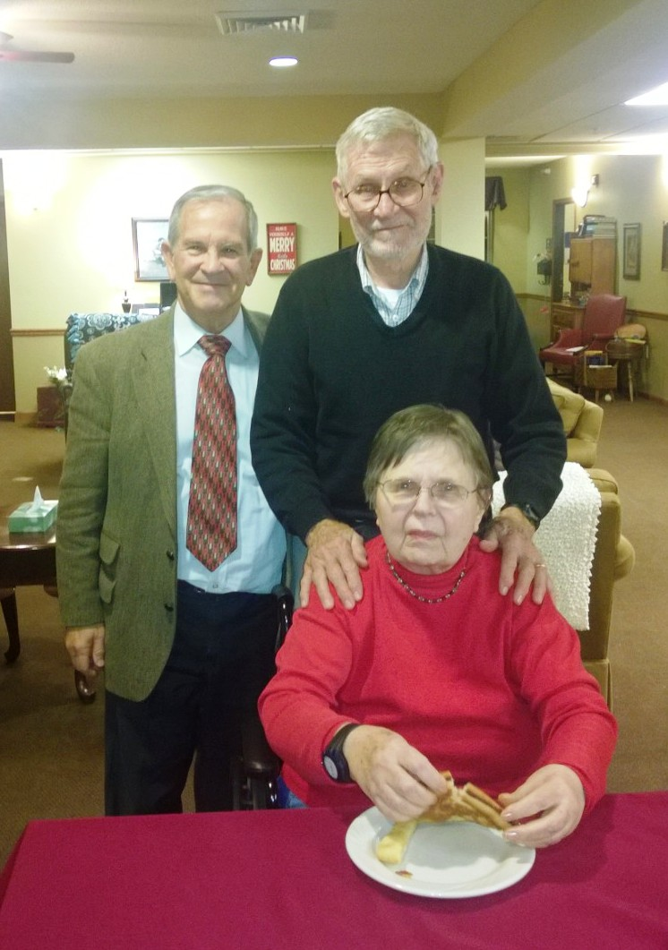
Alzheimer’s patient put in hospice on April 8 2015.
3 CT X-ray scans of brain July-Aug 2015
Quick recovery of appetite, cognition
Discharged Nov 20
Parkinson patient; just one CT scan stopped the tremors
These are facts!
Parkinson
patient
Author
Alzheimer’s
patient

Slide 2
Are your health and longevity important?
Once upon a time, low doses of IR were used to:
Cure cancer (complete remission)
Cure infections: gas gangrene, boils, sinus, inner ear, whooping cough, pneumonia, etc.
Treat inflammations: arthritis, colitis, etc.
Cure asthma
Now: Treat Alzheimer’s & Parkinson disease
with no evidence of increased risk of cancer

Slide 3
Applicability of Radiation response models to low-dose protection Standards
American nuclear society & health physics society
Joint topical, september 30 to october 3, 2018
Tri-cities, washington
Evidence of Thresholds Enables Use of Low-Dose Radiation to Treat Diseases
Jerry M. Cuttler D.Sc., P.Eng.
Cuttler & Associates Inc.
Toronto, Ontario, Canada

Slide 4
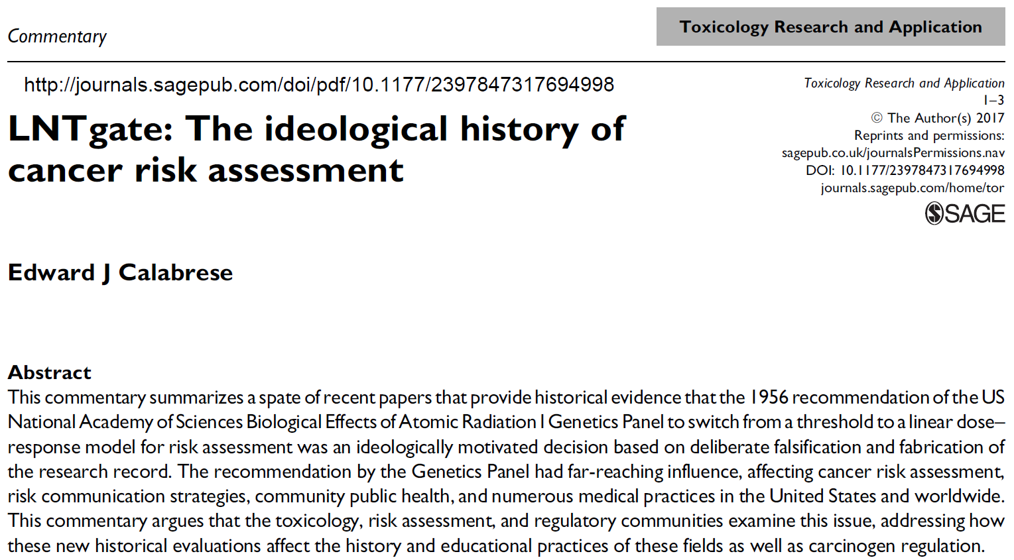
Is the LNT wrong? Is it false?
What about this Scientific Misconduct?

Slide 5
Evidence of:
Acute dose threshold
Chronic dose-rate threshold

Slide 6
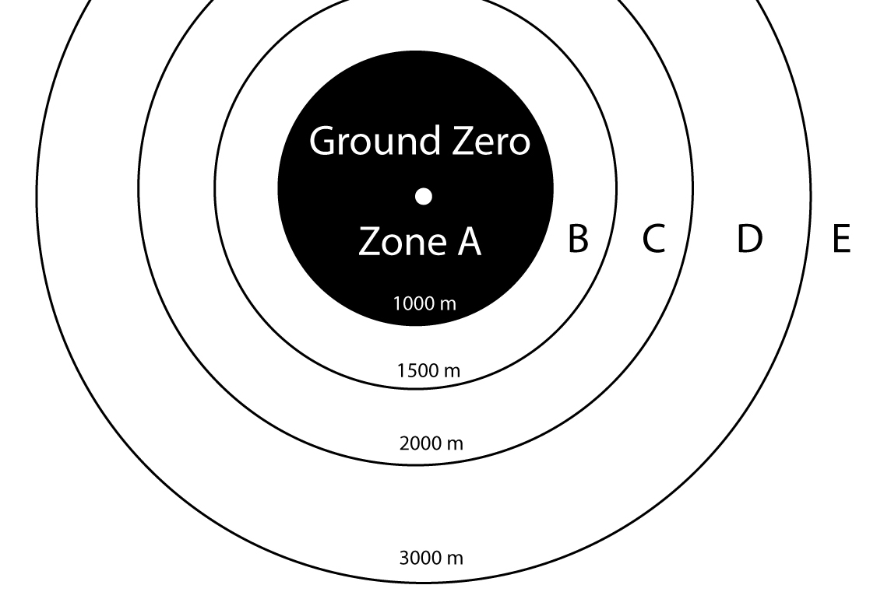
Hiroshima atomic bomb survivor zones

Slide 7
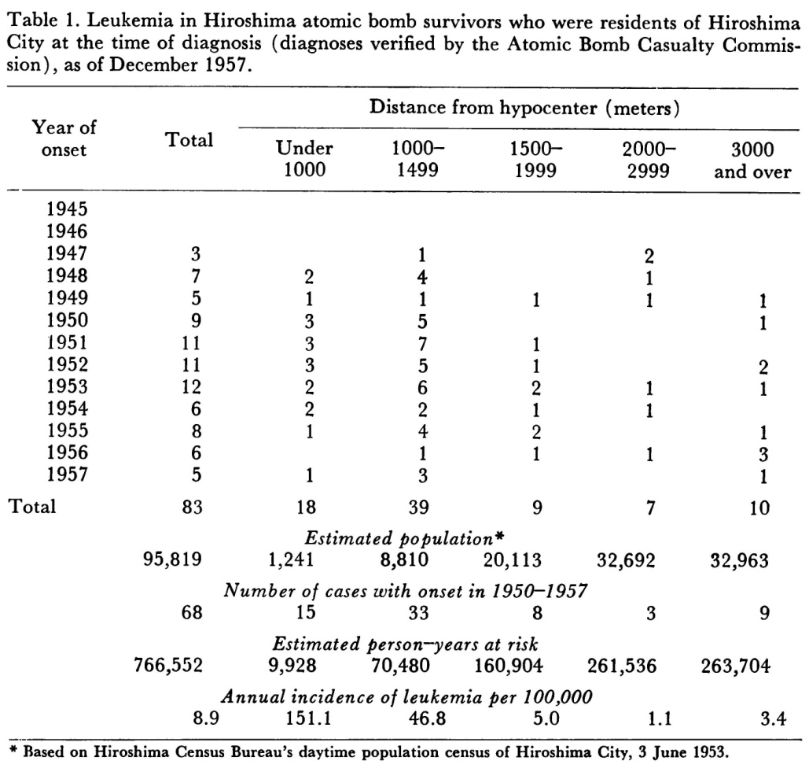
Leukemia data 95,819 Hiroshima survivors
Niel Wald. Leukemia in Hiroshima City atomic bomb survivors. Science. 1958; 127:699-700

Slide 8
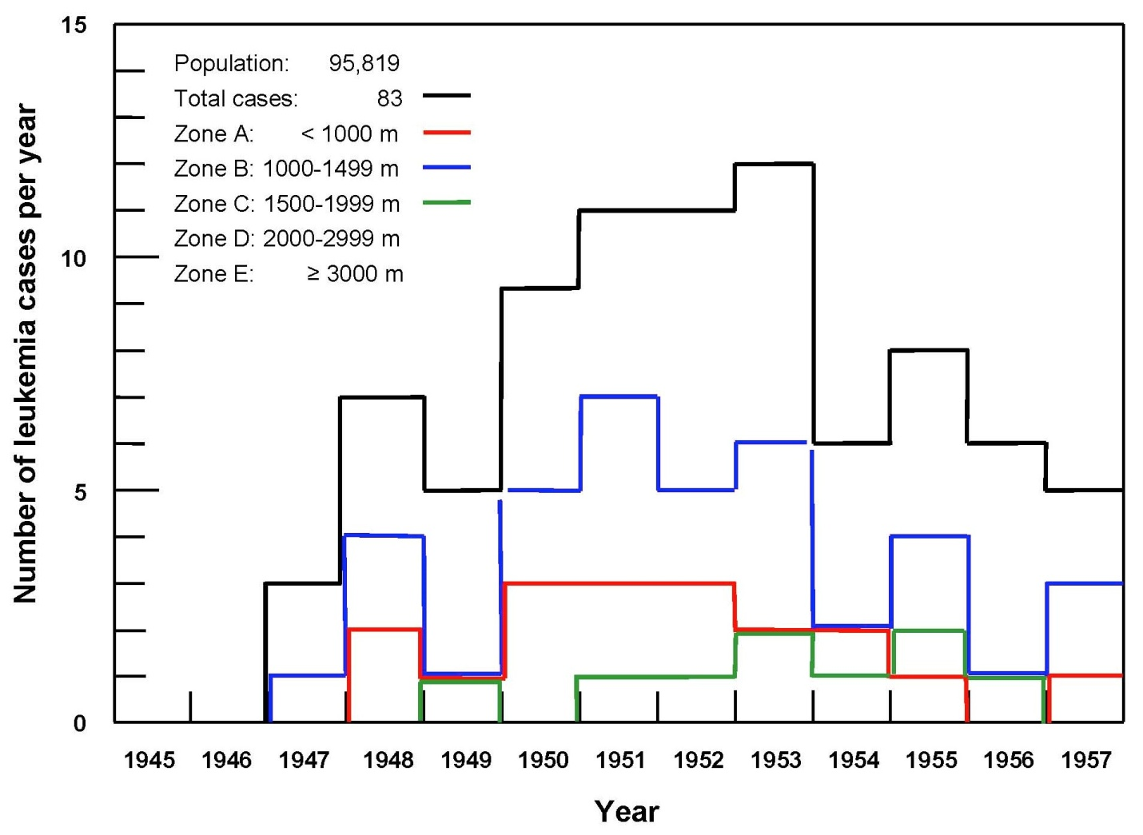
Number of leukemia cases per year

Slide 9
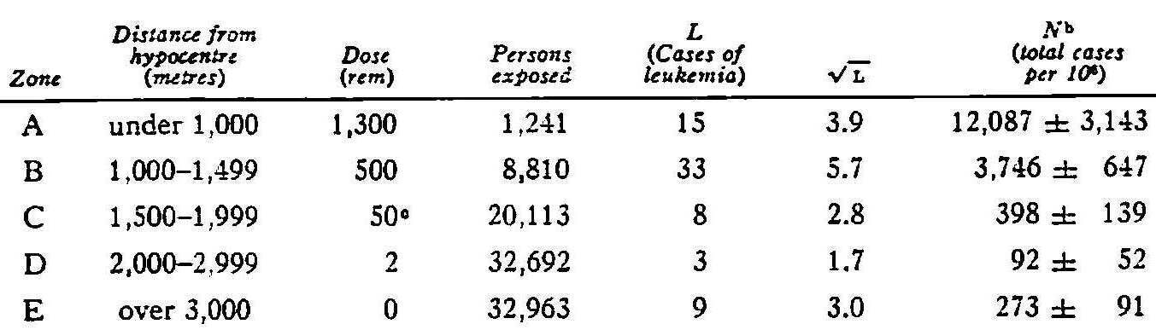
UNSCEAR 1958 Table VII
Leukemia incidence for 1950–57 after exposure at Hiroshimaª
^{c} It has been noted (reference 15, 16) that almost all cases of leukemia in this zone occurred in patients who had severe radiation complaints, indicating that their doses were greater than 50 rem.

Slide 10
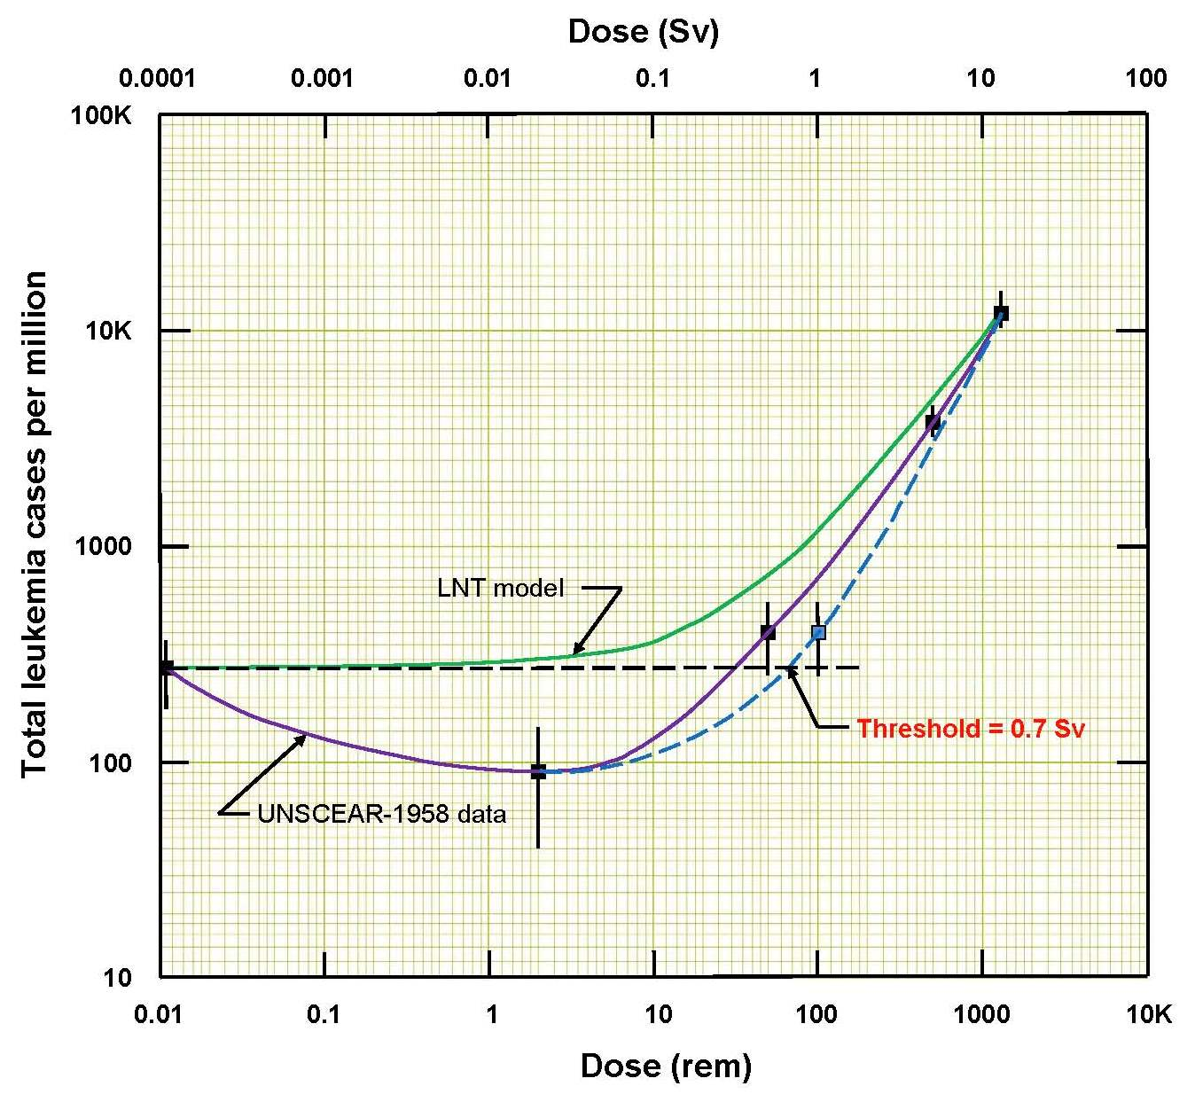
Acute dose threshold at ~ 700 mSv

Slide 11
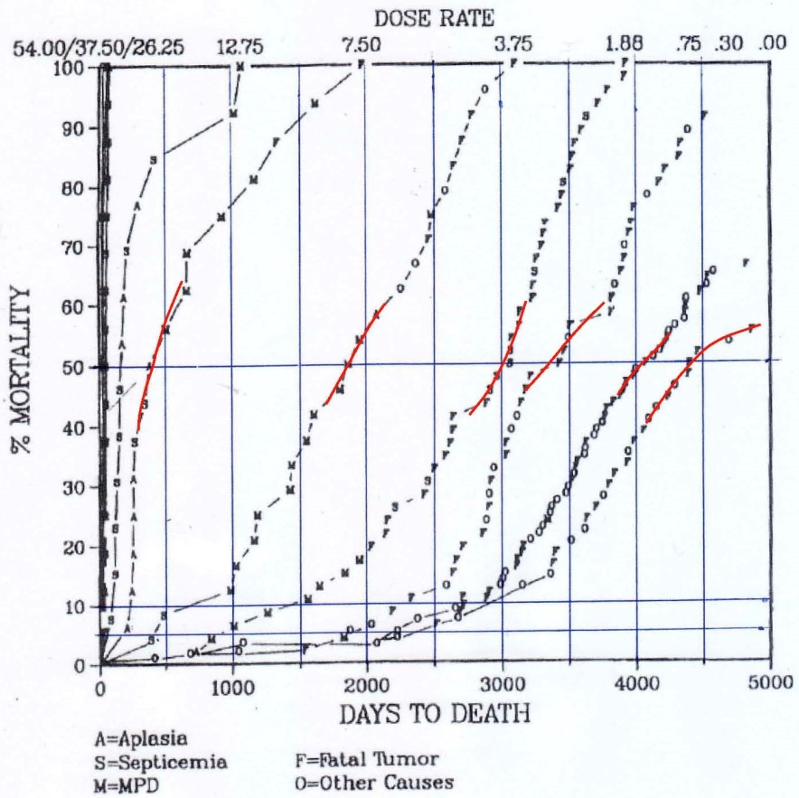
Dog lifespan vs. chronic dose rate (Co-60)
Fritz TE. 2002 Br J Radiology Supplement 26 Page 103-111

Slide 12
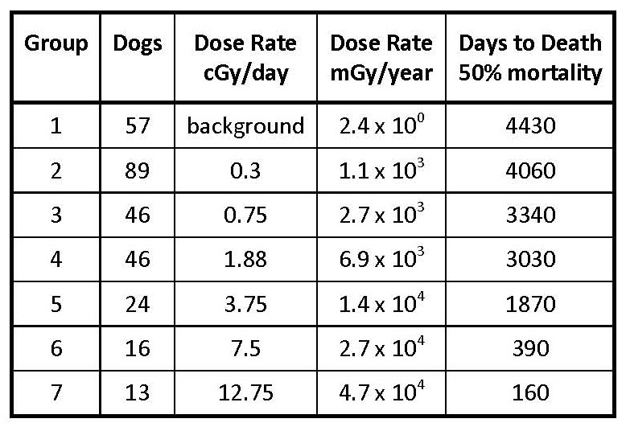

Slide 13
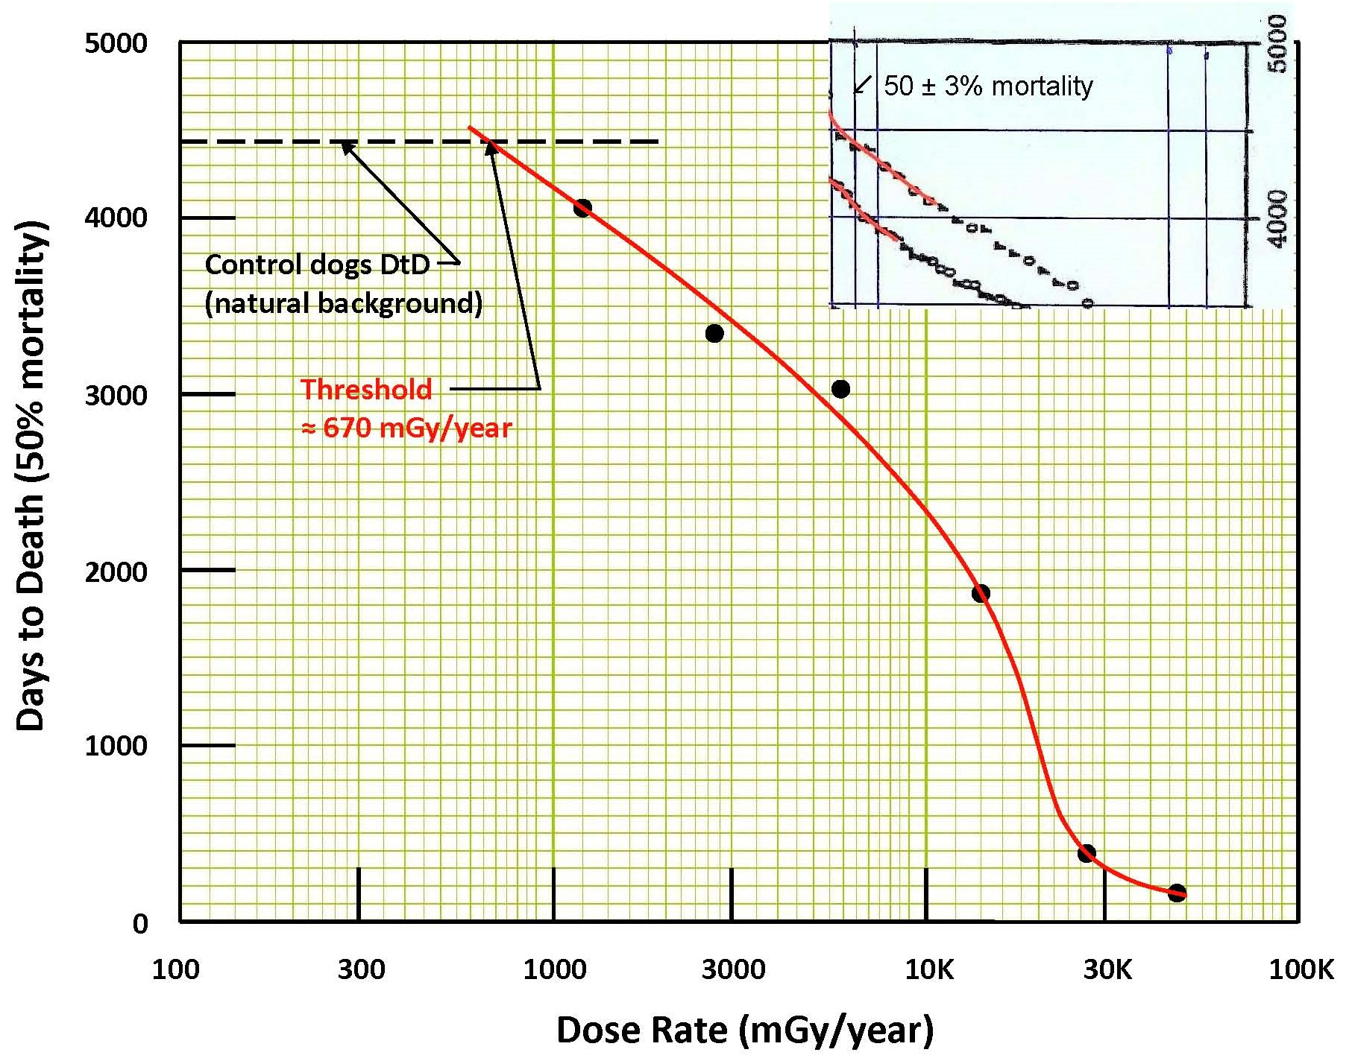
Chronic dose-rate threshold at 670 mGy/year

Slide 14
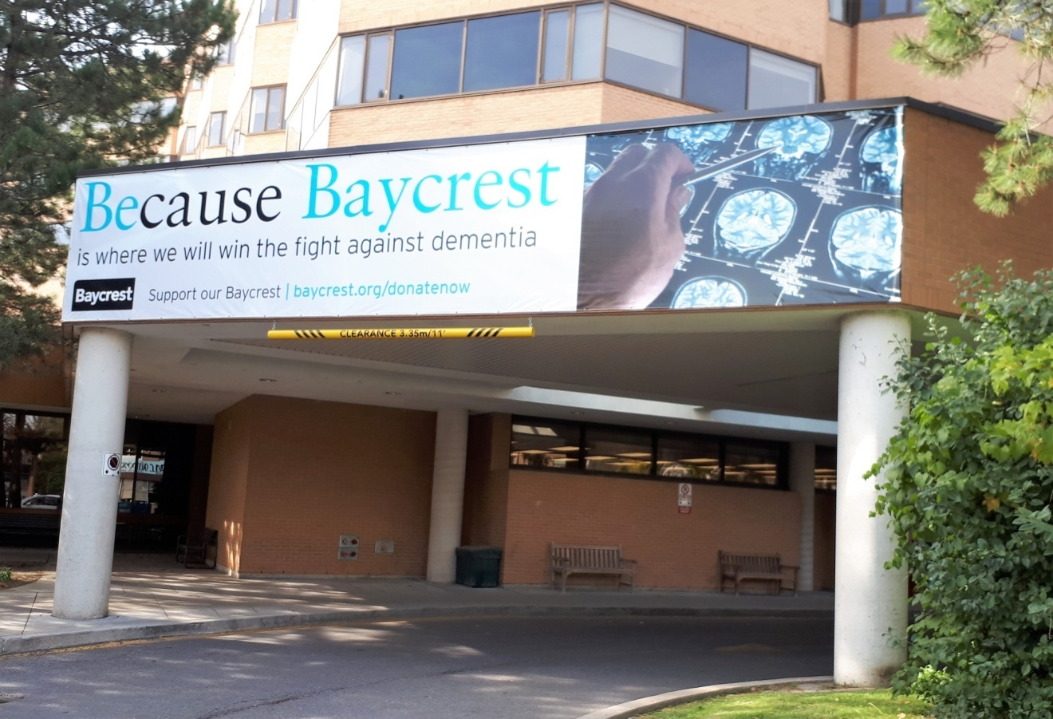
Pilot study LDIR-CT-AD in Toronto, Canada
I urged many scientists to repeat Midland, Michigan therapy
Success at Baycrest (Geriatrics) Health Sciences in Toronto
Baycrest is where we will win the fight against dementia

Slide 15
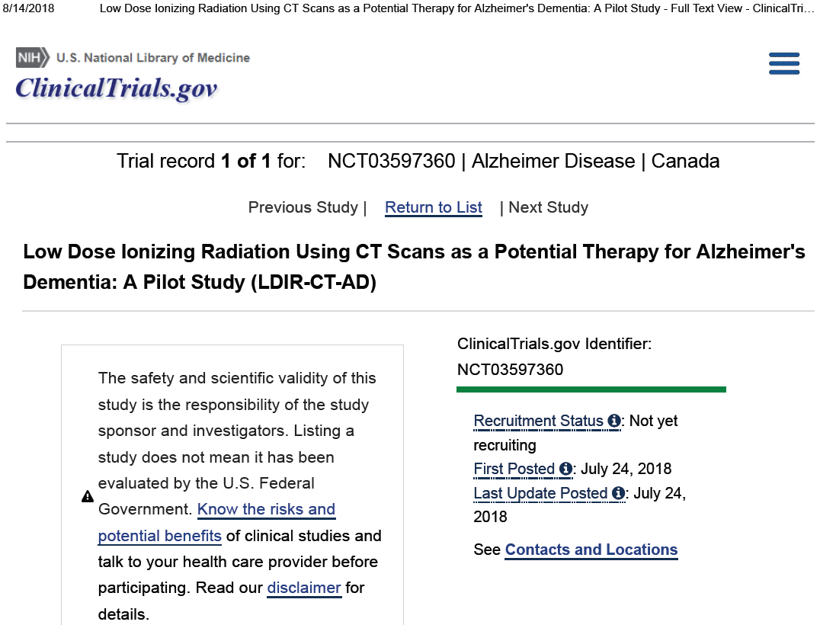

Slide 16
Nasal Radium Irradiation (NRI)
US CDC estimate: up to 2,600,000 children received NRI from 1945-1961 as a standard medical practice to shrink adenoids. Typical Navy protocol: four 10 minute irradiations 2-4 weeks apart. Contact gamma dose = 2000 rad (20 Gy); 1 cm depth dose = 206 rad (2 Gy) Beta dose 68 rad (0.7 Gy) from each applicator. Excess lymphoid tissue at Eustachian tube openings tended to prevent pressure equalization, aggravation middle ear problems.
Notes:
16

Slide 17
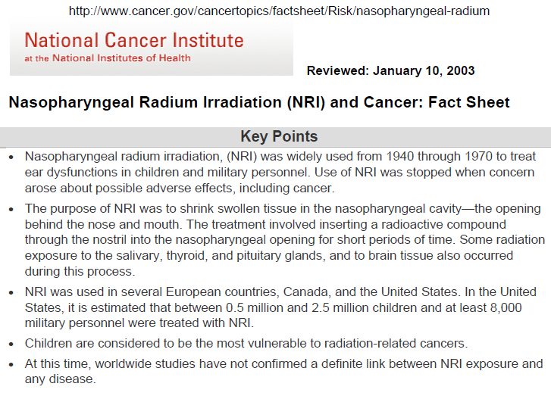
No link to any disease

Slide 18
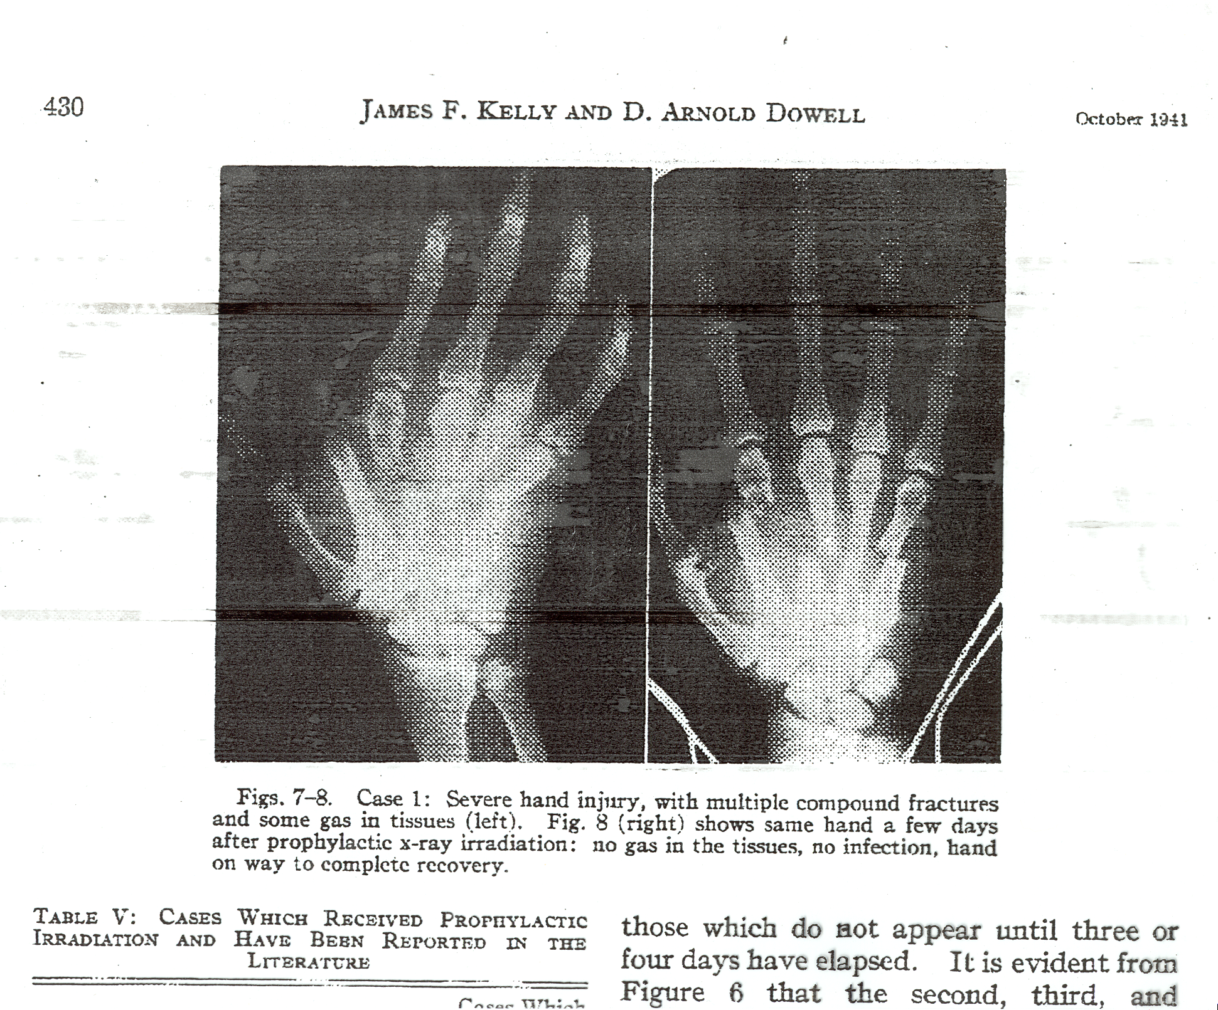
LDR cures gas gangrene infections

Slide 19
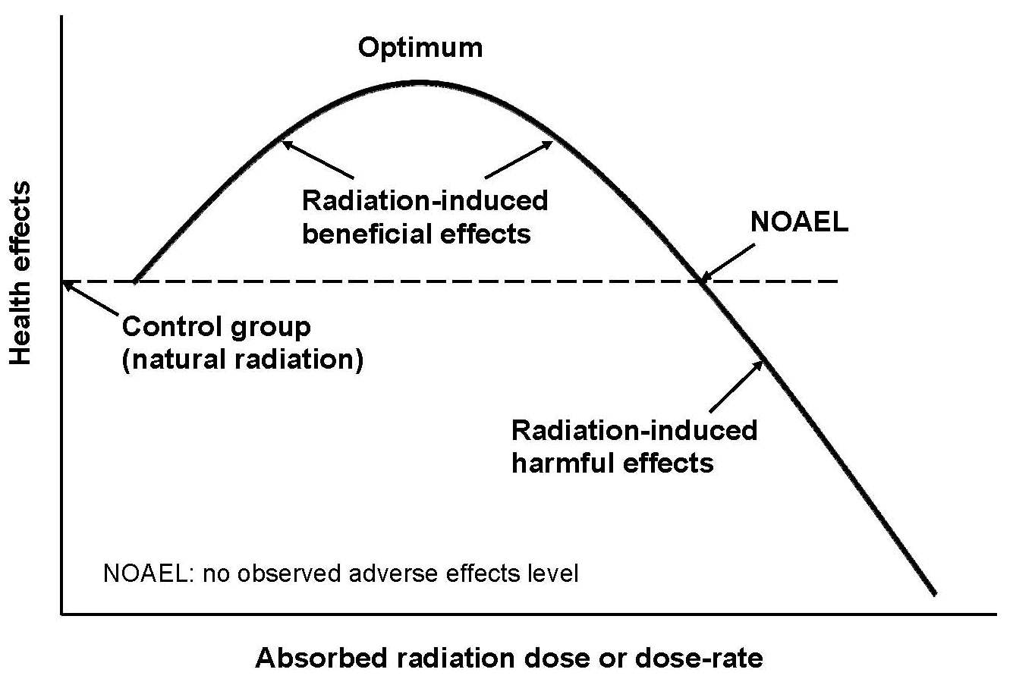
Radiation dose-response models
Threshold
LNT (for cancer)

Slide 20
Questions?

